Slide 1
Chapter 9
Pointers and Dynamic Arrays
Dai Liyun

Slide 2
Overview
9.1 POINTERS
9.2 DYNAMIC ARRAYS

Slide 3
9.1 POINTERS

Slide 4

Declare
double *p;
int *p1, *p2, v1, v2;
p1 = &v1;
assignment

Slide 5
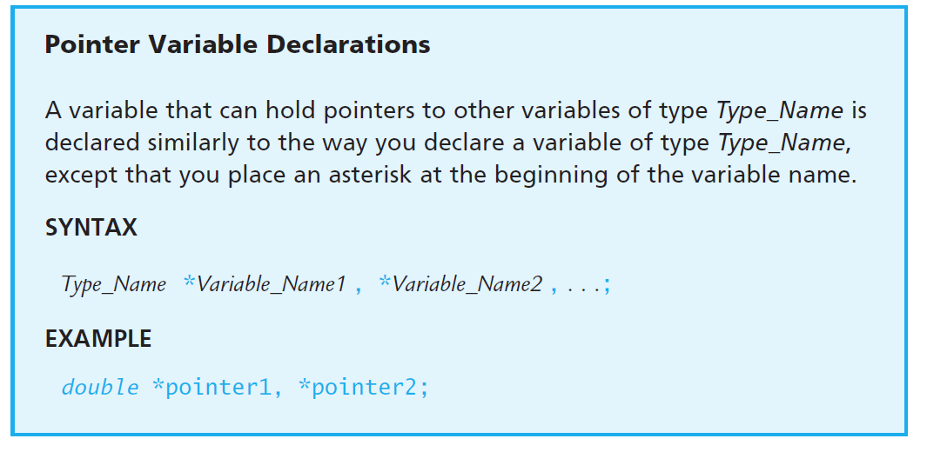
Declare

